Slide 1
CarCommunity Maintenance Center - Project Documentation
This document is intended for software engineers, DevOps engineers, and technical product managers responsible for building and maintaining the multi-tenant CarCommunity platform (ASP.NET Core + Angular).
The document provides a technical overview, architectural details, and quick-start guidelines to facilitate understanding and work on the project. The platform is designed to provide integrated services for car owners and service providers.

Slide 2

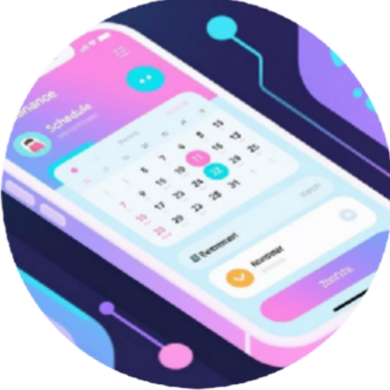


Project Overview and Key Features
The Car Community Maintenance Center is a comprehensive platform that allows car owners, maintenance shops, and spare parts sellers to manage vehicles, schedules, community interactions, and business transactions.
Vehicle Management
Maintenance Scheduling and Reminders
E-Marketplace (Marketplace)
Augmented Reality (AR) Experiences
Registering cars, uploading photos, and viewing detailed maintenance history for each vehicle.
Scheduling services, with automatic reminders via email and SMS.
Buying and selling spare parts, payment via Stripe, and efficient order tracking.
Pointing the phone towards the car to view live diagnostics, maintenance tips, and part details.
The platform features Multi-tenant support where each client gets an isolated subdomain (e.g., {tenant}.mycarcommunity.com), and full support for Dark-Mode and Arabic language (RTL).

Slide 3
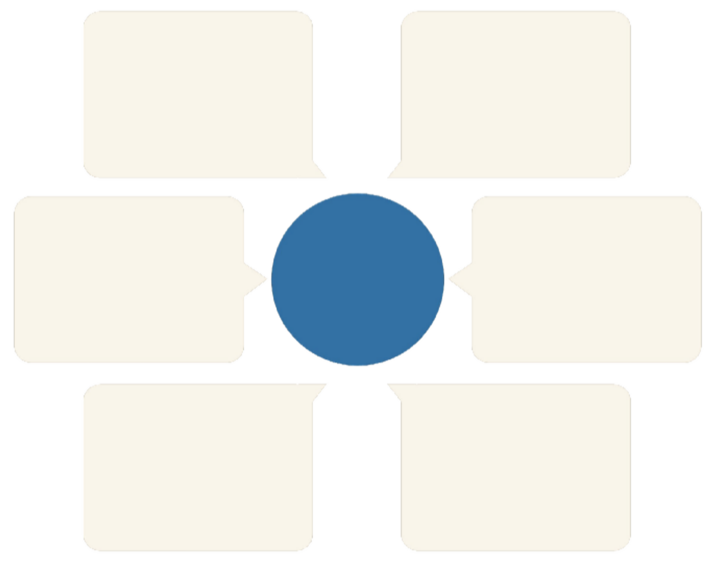
Key Architectural Components
The platform is built on a modern model focusing on scalability and reliability. All services are centered around an API Gateway to ensure security and proper request routing.
Terraform & GitHub Actions
API Gateway
Infrastructure deployment and automated operations
Central point for request routing
Stripe Webhooks
Integration Architecture
SignalR + Redis
Payment notifications to API Gateway
Real-time communication and caching
Hangfire
EF Core Database
Scheduled tasks connecting to the database
Data management and tenant isolation

Slide 4





Prerequisites and Tools
To begin working on the project locally, a specific set of tools must be installed to ensure environment compatibility with ASP.NET Core 9 and Angular 18 requirements.
.NET SDK 9.0
Or .NET 8 LTS with
Node.js 20.x LTS
Required to run and build Angular applications.
Docker Desktop and Docker Compose v2
To run local dependent services (databases, Redis, etc.).
TargetFramework
modification.
Visual Studio 2022 / VS Code
Recommended development environment.
Terraform 1.9+ and Helm 3.14+
For infrastructure automation and deployment (optional for local work).

Slide 5

Getting Started - Local Setup and Development
Local setup requires an environment file (.env) containing the necessary secret keys to run services like the database, Stripe, and OpenAI, followed by running Docker Compose.
Step 4.3: Build and Run with Docker Compose
The backend (API) runs on port 5000, and the web interface (SPA) on port 4200. SQL Server and Redis databases are automatically provisioned.
Basic running commands:
git clone https://github.com/yourorg/car-community-saas.gitcd car-community-saas# Step 4.3: Build and run servicesdocker compose up -d --build
Check Backend (Swagger): http://localhost:5000/swagger
Check User Interface (SPA): http://localhost:4200
Important Note: You must run
docker compose exec api dotnet ef database update
only once to apply database migrations on the first run.

Slide 6
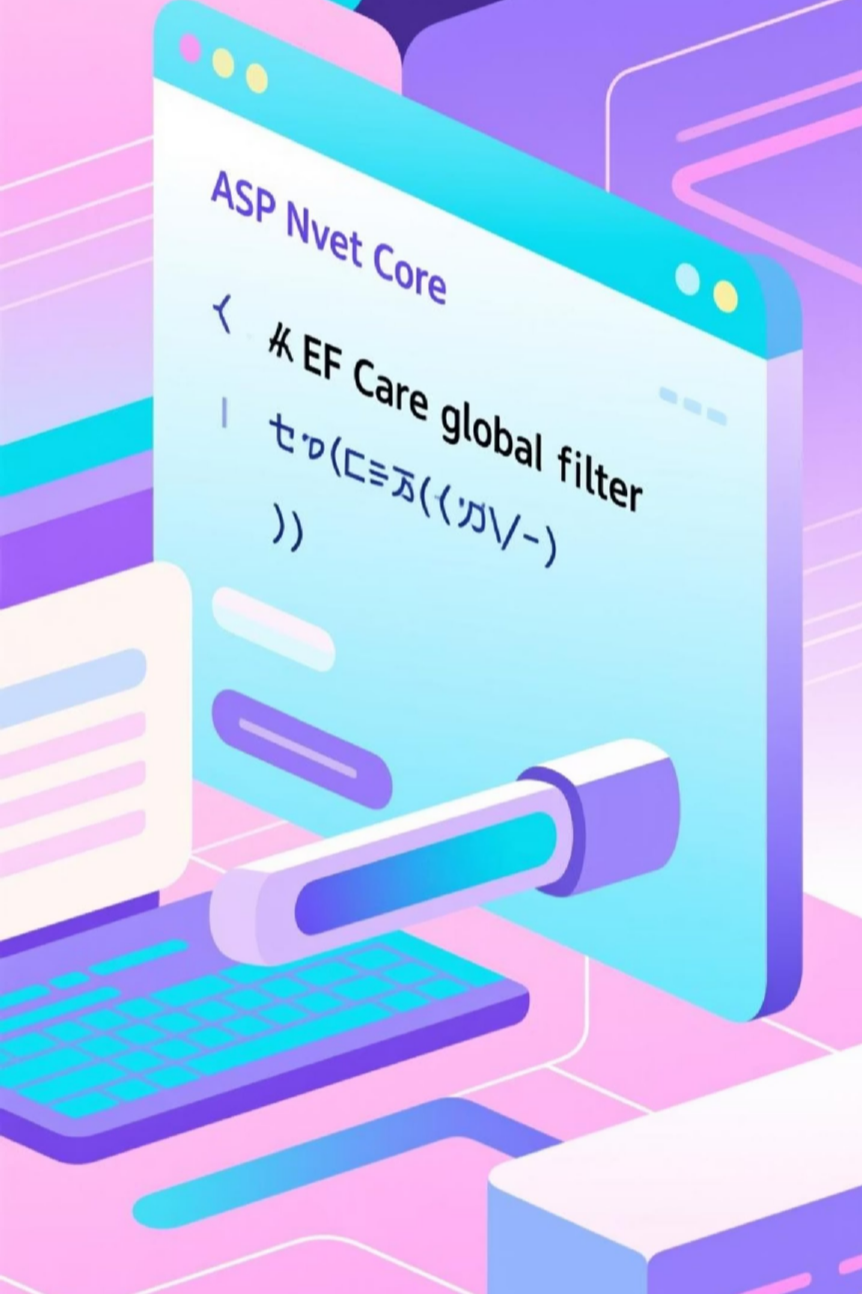
Backend: ASP.NET Core 9
The backend project structure follows a standard pattern, focusing on tenant isolation via utilizing EF Core global query filters.
ITenantEntity
and
Key concepts governing the backend:
Tenant Isolation
Every data entity includes a
TenantId
, and a filter is applied to ensure each tenant accesses only their own
data:
HasQueryFilter(e => EF.Property(e, "TenantId") == GetCurrentTenantId());
Feature Flags Management
The
FeatureFlag
table defines the features available to each tenant based on their Plan. Templates are
copied when a new tenant is provisioned.
Provisioning Service
Responsible for creating the tenant, Stripe customer, admin user, copying initial feature settings, and sending the welcome email.
Real-time Conversations
AiChatHub
and
HumanChatHub
(depending on features) are used with
PresenceHub
to track user status
and send notifications.

Slide 7
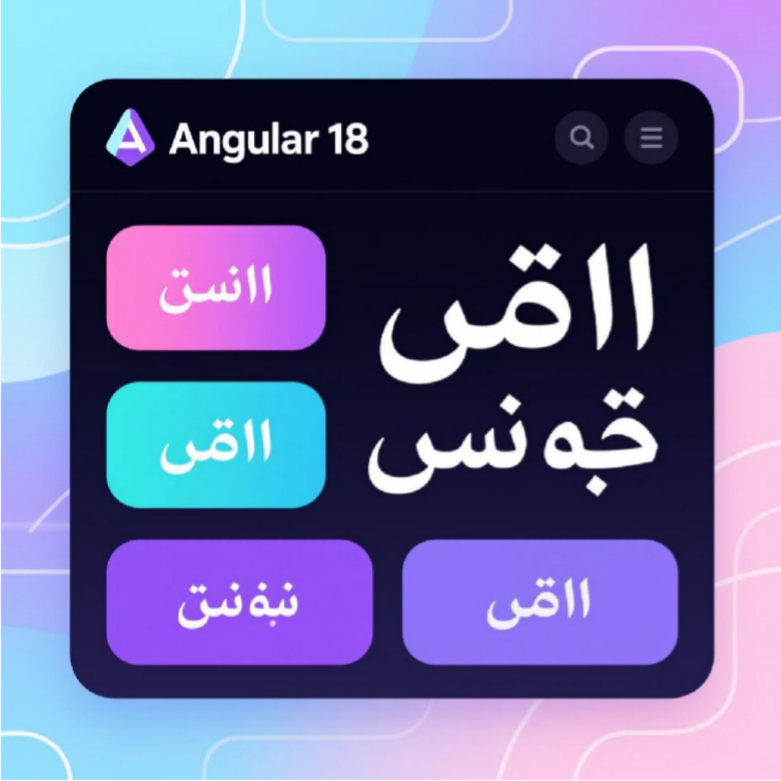
Frontend: Angular 18
The user interface is built using Angular 18 and relies on the
NgRx
pattern for state management. The interface is designed to support advanced
features such as Augmented Reality (AR), multilingualism (RTL with Arabic), and dark mode.
FeatureFlagService
service: Queries
/api/tenant/flags
and exposes the
can(key)
function to control the visibility of features based on the tenant's plan.
ThemeService
service: Toggles light/dark mode and stores the preference locally.
I18nService
service: Uses
ngx-translate
to switch languages and set
document.dir
to
support Right-to-Left (RTL) writing.
ArService
service: Manages the
WebXR
lifecycle and loads
GLTF
models for
Augmented Reality display.
Specific pages such as
/chat/human
and
/ar/car/:id
are protected via Guards that
verify feature authorization through the
FeatureFlagService
.
Build command for production: ng build --configuration production

Slide 8
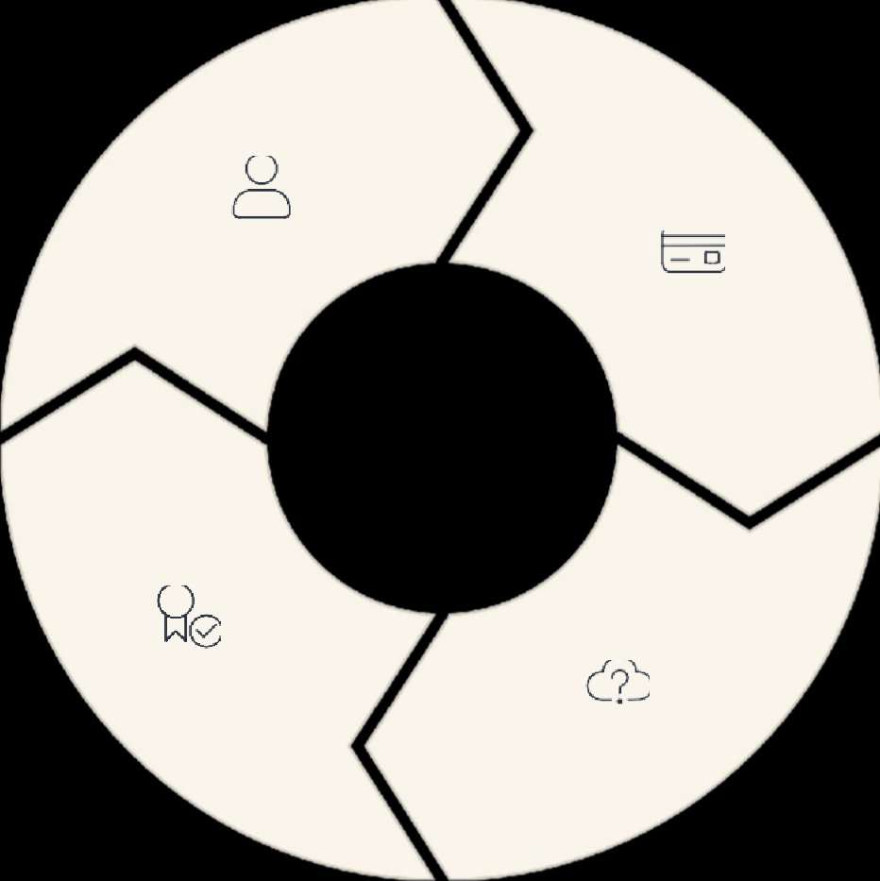
Plans and Invoicing - Stripe Integration
Stripe is used to manage subscriptions and invoicing, ensuring secure and PCI-compliant processing of payment data.
Upgrade/Downgrade
Tenant Provisioning
Create a new Stripe customer for the
tenant.
Update Stripe subscription via
BillingController.ChangePlan
and
update
Feature Flags
locally.
Webhook Processing
Usage Limits
Usage limits (AI tokens, upload size, concurrent devices) are enforced in the
The
/api/stripe/webhook
endpoint
receives notifications from Stripe to process events such as successful payments or subscription deletions.
backend
Middleware
layer.
Example of monthly AI token usage limits: Free 10,000, Pro 100,000, Enterprise 1,000,000.

Slide 9
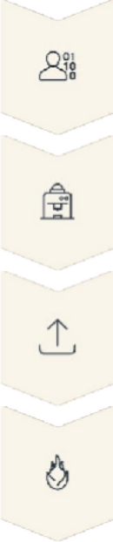
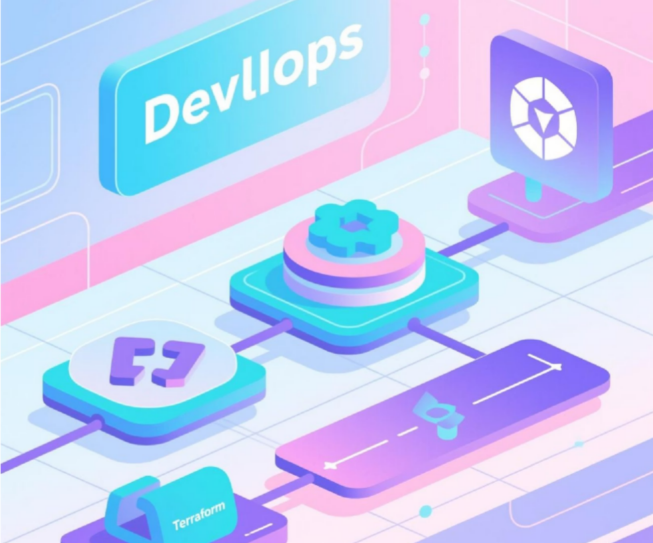
Infrastructure as Code (IaC) and CI/CD
We use Terraform and Helm to manage infrastructure resources and reliable deployment, ensuring identical and repeatable environments.
Terraform and Helm GitHub Actions Workflow
Terraform is used to provision core cloud resources (Azure AKS, Azure SQL, Key Vault). Helm is used to deploy API and SPA applications, with reference management for secrets.
Build, test, and deployment are automated via GitHub Actions workflows, ensuring consistent deployment when merging changes or creating Release Tags.
Provisioning a resource group (AKS, Azure SQL, ACR, Front Door).
Embedding secret references from Key Vault into Helm values.
Workflow Stages:
Core commands:
terraform apply
and
helm upgrade --install
Build and Test
Build Docker Images
Push Images
Helm Update (Deployment)

Slide 10




Monitoring, Logging, and Security
Comprehensive monitoring and robust security measures are essential for a multi-tenant SaaS platform. We use an integrated suite of tools to ensure visibility and compliance.
Monitoring & Metrics
Structured Logging
We use Application Insights for tracing and telemetry, along with Prometheus and Grafana for metrics and custom dashboards.
Serilog logs are directed to Seq/Elastic, with logs enriched with
TenantId
and
UserId
for easy traceability.
Security & Compliance
Alerting
Short-lived JWT authentication, role-based authorization (RBAC) and feature flags, per-tenant/IP rate limiting, and PCI/GDPR compliance through no card data storage and automated scanning.
Azure Monitor alerts are configured to detect high error rates, Hangfire
job failures, and service health issues via the
/healthz
endpoint.
To ensure security, sensitive secrets are stored in Azure Key Vault, TDE is applied to Azure SQL, and Door.
TLS everywhere
is enforced via Front

